Slide 1
Care Provider Feedback User Testing Synthesis
Nate Sprague

Slide 2
Testing Approach
Given the difficulty of scheduling time with CareGiver registered users, I decided to go with a hybrid approach:
Part 1
Validate feature value with actual CareGiver ICPs
Part 2
Test usability of validated features with non-JH home health care providers recruited through usertesting.com
Moderated

Slide 3
Testing protocol
JH CareGiver ICPs
Home Health Care Providers recruited from usertesting.com
Test 1
3 registered CareGiver app users participated in a two part moderated session.
Part 1: Participants were asked background questions and talked through their current experience with the CareGiver app.
Part 2: Participants walked through the multiple new features of the app and talked through their understanding and perceived value as a user of the app.
Note – I will be pursuing ongoing testing/feedback sessions with more registered CareGiver users
Target Audience & Recruiting Criteria
30-65+ years old, Employed full-time or part-time in the health care and pharmaceutical industry with a job role as healthcare services. Screener question of “Have you ever provided care to someone at their home?” rejected users from the test if they answered “no”.
Test 2
25 participants walked through the multiple new features of the app and talked through their understanding and perceived value as a potential user of the app.
Test 3
25 participants were shown 3 versions of a potential home screen and asked to navigate to different sessions throughout the week, provide what time the sessions were, and rate the difficulty finding them. They were then asked which version they found their favorite and most user-friendly version was.

Slide 4
Results: Test 1 – JH CareGiver users

Slide 5
Test 1: Moderated testing with CareGiver Users
Part 1: Participant background and current experience
• 3/3 participants experience log in issues with the current production app
• 1/3 participants have non-John Hancock clients
• 2/3 participants use the session timer
• 2/3 participants only use the app once a week
• 3/3 participants enter sessions in the past
• 3/3 participants have had to enter sessions in the past because their active session crashed or experienced a problem
• 2/3 participants noted their known password not working to log in
“
“
“Only on Fridays when I input sessions for week. I keep track of hours and then add sessions at the end of the week. I would probably open it more if hadn't been broken.”
“..sometimes have to put it in after the fact. Same with care providers.. Not always being able to get into the app they add them after.”
“
“every single time I would put the password that I knew was my password, but I’d have to call and have them reset it. So from then on I’d only log in once a week to make it easier.”

Slide 6
Test 1: Moderated testing with CareGiver Users
Part 2: Participant feature value and feedback
• 3/3 participants found value in being able to schedule sessions
• 2/3 participants understood that the they were viewing their upcoming sessions on the home page
• 3/3 participants typically meet with their clients on recurring days
• 3/3 participants found value in adding notes to sessions
• 3/3 participants were confused by the invoice page and each have unique work flows for invoicing
• 3/3 participants would prefer to see the hourly rate set within customer details
“
“
“I like seeing the list of customers separately but I think the calendar is going to be the most helpful thing. The calendar is nice for scheduling and inputting things ahead of time.”
“I show my customer the app, we approve the times/amounts together”
“
“
“Yes, it would be nice to import appointments from my calendar to the CareGiver calendar”
“Setting up the day of the week is probably more important”

Slide 7
Test 1: Moderated testing with CareGiver Users
Part 3: Notifications and location tracking
• 1/2 participants were comfortable turning their location on
• 1/3 participants noted that data signal is bad at their client’s house
• 3/3 participants found value in being notified about sessions
Participants that were okay with location tracking had a positive response to being notified via location tracking
“
“
“You're getting paid for a service that requires you to make sure you actually in their home, so it totally makes sense to track location.”
“This would be helpful, however, I'd need to be able to adjust the times to make sure they're accurate”
“
“
“If you are automatically starting and stopping sessions it would be nice to round the session start/end times to the nearest 5-10 minutes”
"That feels icky. I don't like that. I don't like anyone tracking me. I wouldn't even let my daughter track me.”

Slide 8
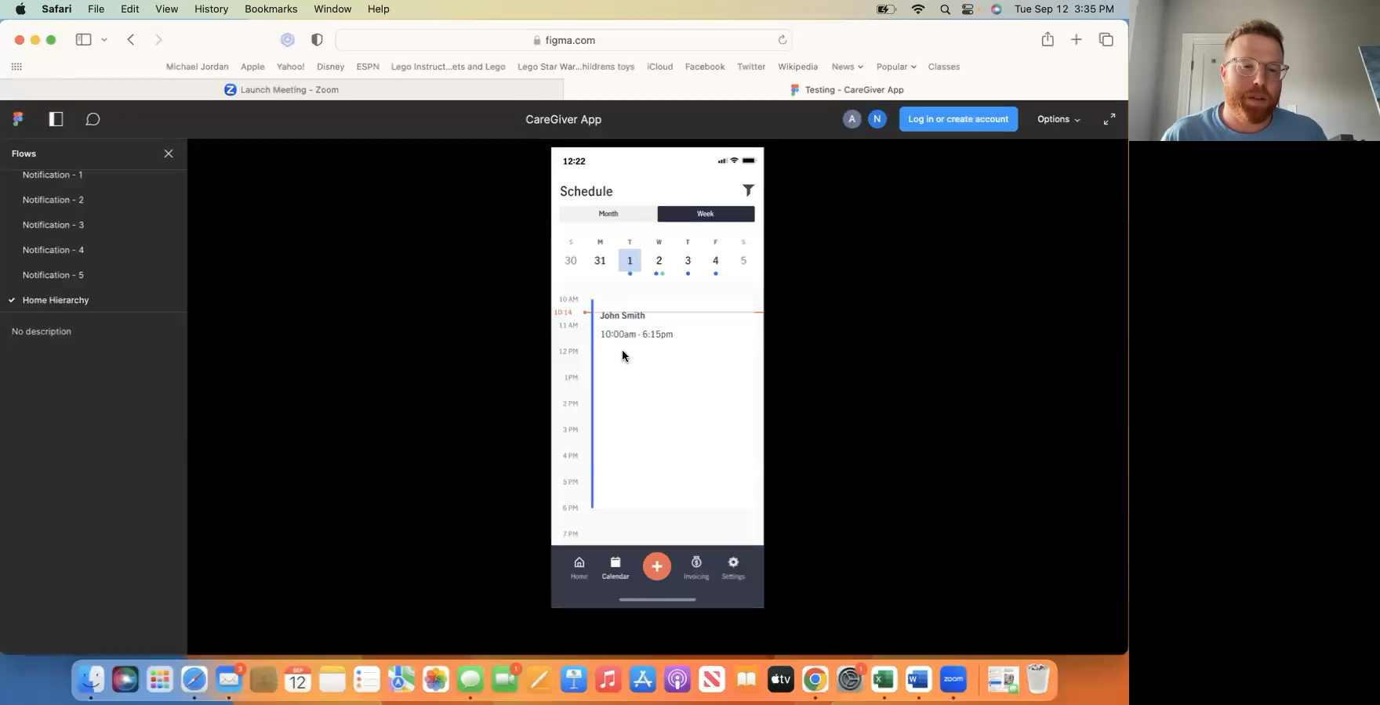
Test 1: Video Highlight

Slide 9
Results: Test 2 – non-JH Feedback

Slide 10
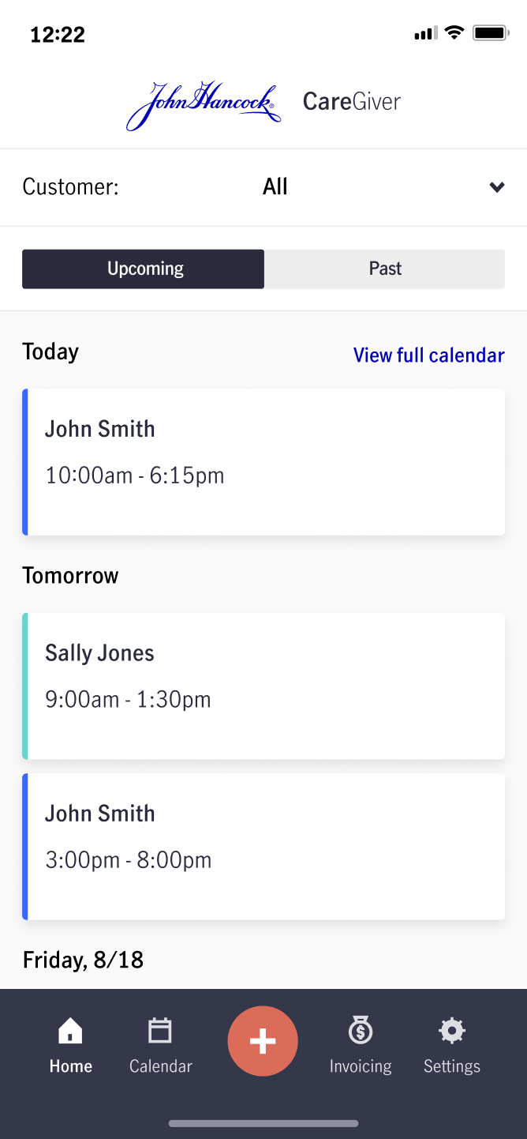
Test 2: Unmoderated Care Giver Feedback Session
25 participants were given a similar prototype to the one that JH CareGiver ICPs walked through and asked about general understanding of the content
• 23/25 participants found the prototype easy to understand
• 23/25 participants were able to add a session to their schedule
• 25/25 participants knew that the orange “plus” button would start or add a session to their schedule
• 24/25 were able to fill out the information to add a session to their schedule
“
“
“I’ve done some other user testing sessions that were confusing but I thought this one made a lot of sense and was easy!”
”Ours is just like this.. This is pretty cool. I can see that this is my schedule. I like being able see my upcoming, past, and filtering to see just certain clients.”
“
“
“The content is very clear and proficient. I like it a lot.
“I don’t typically see invoicing in my system when I go into mine”

Slide 11
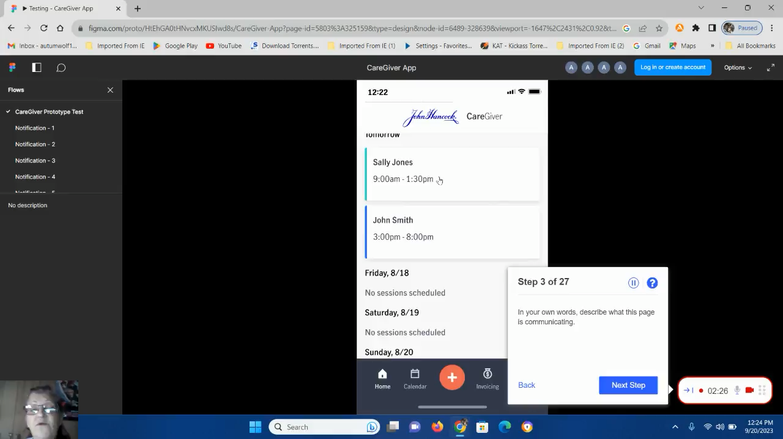
Test 2: Video highlight

Slide 12
Results: Test 3 – non-JH Home Screen Test

Slide 13
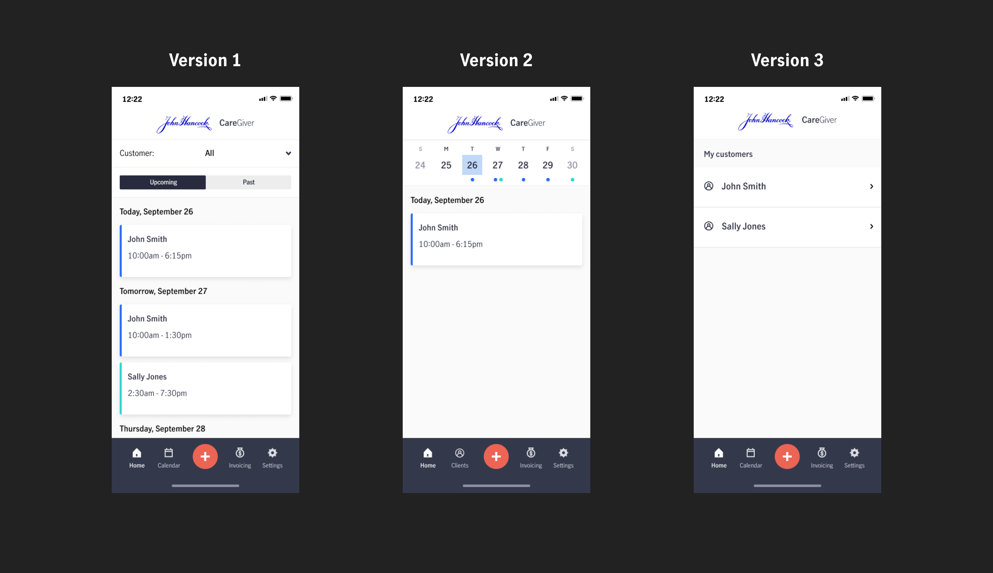
Test 3: Unmoderated Home screen test
Users were asked find session details for each version they were shown and then rate the difficulty of the task.

Slide 14
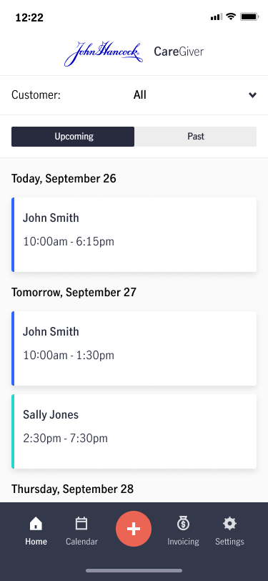
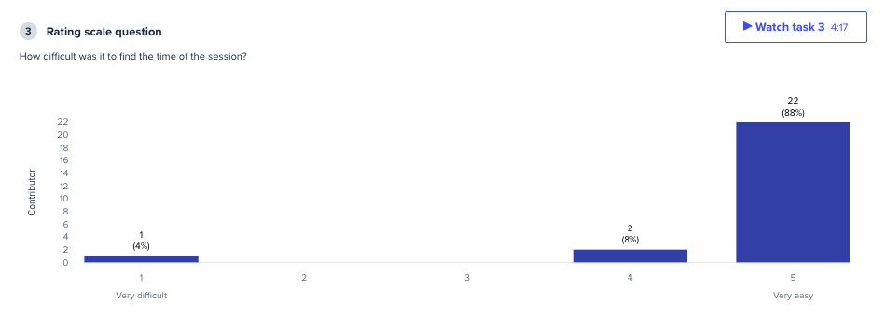
Test 3: Unmoderated Home screen test
In each version 25/25 participants were able to correctly identify the time of the session asked about.
Ie. “What time is your session with Sally Jones on Saturday, September 30?”
Of the 3 versions and 4 tasks given, participants rated version 1 and 2 the easiest, with version 3 slightly more difficult to find sessions
Version 1

Slide 15
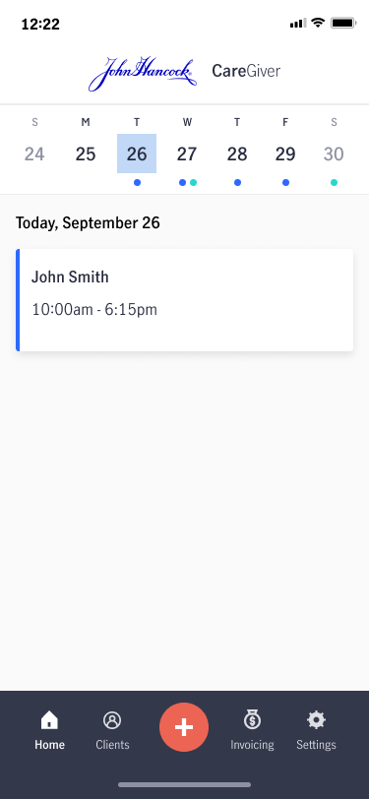
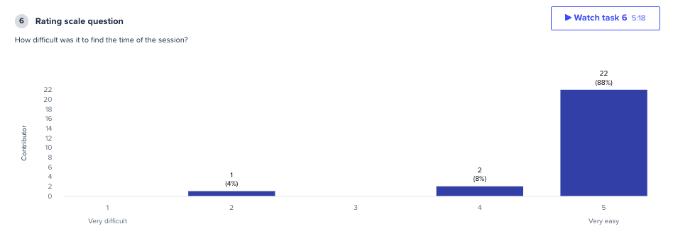
Test 3: Unmoderated Home screen test
In each version 25/25 participants were able to correctly identify the time of the session asked about.
Ie. “What time is your session with Sally Jones on Saturday, September 30?”
Of the 3 versions and 4 tasks given, participants rated version 1 and 2 the easiest, with version 3 slightly more difficult to find sessions
Version 2

Slide 16
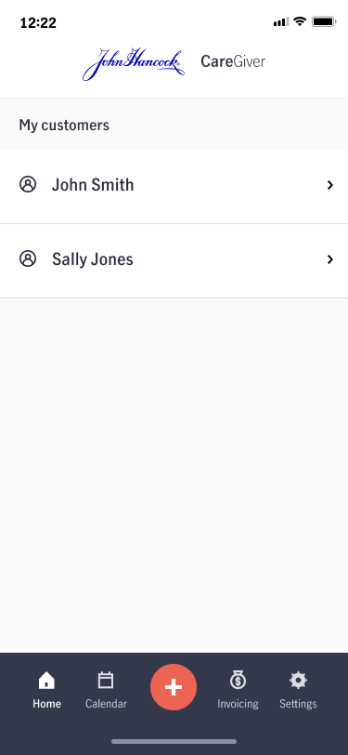
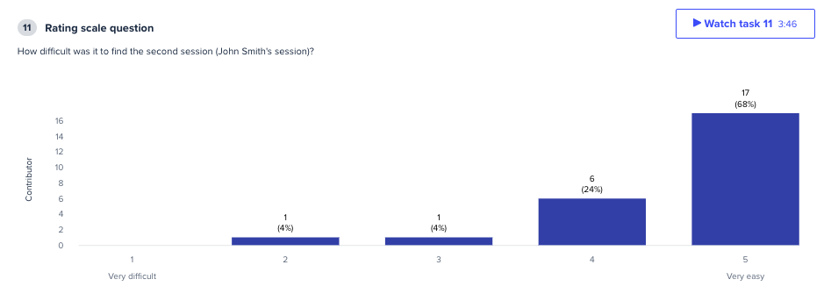
Test 3: Unmoderated Home screen test
In each version 25/25 participants were able to correctly identify the time of the session asked about.
Ie. “What time is your session with Sally Jones on Saturday, September 30?”
Of the 3 versions and 4 tasks given, participants rated version 1 and 2 the easiest, with version 3 slightly more difficult to find sessions
Version 3

Slide 17
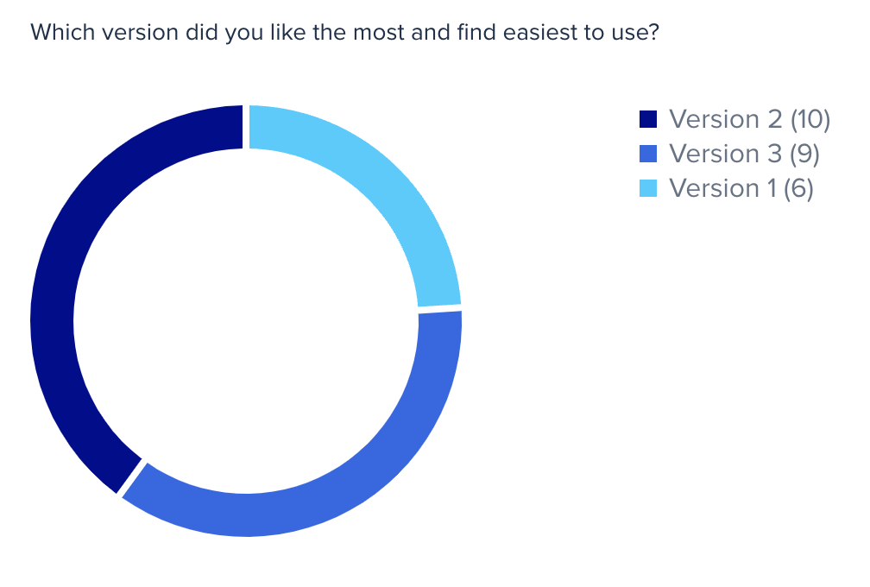
Test 3: Unmoderated Home screen test
16/25 participants chose a schedule based home page
9/25 participants chose a client based home page
“
Version 2 helps you see all your appointments for all patients for the whole day without missing any information about different patients like in version 3
“
I like that I can click on the calendar date to see appointments for that day. I also like the calendar is set up with different color dots so that I can see that there are different appoints for different clients to see. I like that once I click on the date, there isn't too much information to sort through, only what is on that day.

Slide 18
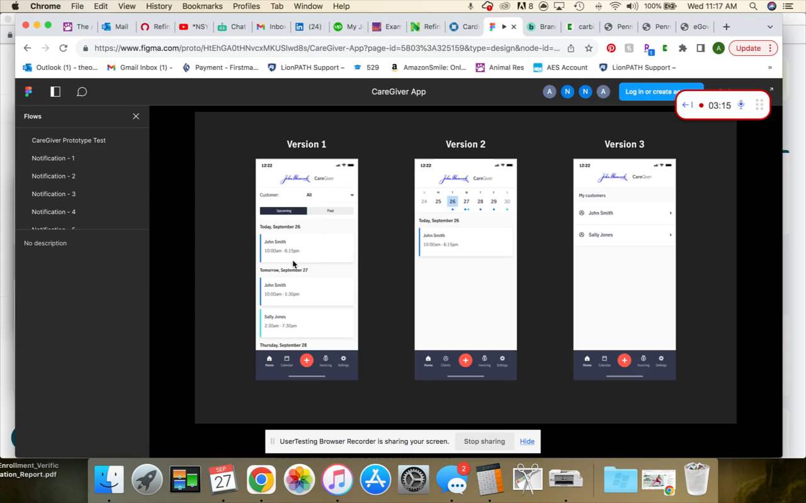
Test 3: Video Highlight

Slide 19
Findings and Recommendations

Slide 20
Findings and Recommendations
Finding:
Users found the most value in viewing their schedule of upcoming appointments. Sessions are typically recurring on the same days throughout the week. 16/25 participants chose the schedule as their preferred home screen. Of the 16 participants that chose the schedule, 10/16 chose to see day and week in the same view.
1.
Schedule & Sessions
Recommendation:
Present a hybrid daily/weekly view of sessions to the user so they can easily see today’s session as well any recurring sessions throughout the week. This will give them a snapshot of their day and their week.

Slide 21
Findings and Recommendations
Finding:
Users found the list of clients to be the next most valuable thing to see. 9/25 participants chose the client view as their preferred starting point.
2.
Recommendation:
Place a “client” tab as the second main navigation item. This will allow for a place to view all client information, hourly rates, and can serve as link to view client-filtered schedules as well.
Clients

Slide 22
Findings and Recommendations
Finding:
Users did not expect to see hourly rate and clients in their settings.
3.
Recommendation:
Reiterating on the previous recommendation – create a client tab in the main navigation to store this information.
Hourly rate

Slide 23
Findings and Recommendations
Finding:
Users were concerned about accurate start and end times. There will need to be a trigger for scheduled sessions to be sent to storefront.
4.
Recommendation:
There may be a need for ICPs to review session details after a session or end of week to be sent to the insured’s storefront account.
Review session details

Slide 24
Findings and Recommendations
Finding:
Users each have a unique workflow of invoicing their client. They don’t want to have to send each session over individually and would like to know which past sessions have been paid/reimbursed.
5.
Recommendation:
Invoicing
Create a clear system of which past sessions have been approved, paid, sent back for correction, or experienced some type of error. Make sure there is a clear distinction between sessions that the client has been reimbursed for – and the ICP has been paid for in the invoice tab.

Slide 25
Findings and Recommendations
Finding:
Other interactions participants had a positive response to: notes within session detail screen, filtering/sorting, color-coding clients, recurring sessions, and chat/call support.
6.
Recommendation:
Miscellaneous interactions
Ensure that these features are ubiquitous throughout the app. Some of them were shown to users, while others will make their way into the next iteration of designs.

Slide 26
Findings and Recommendations
Finding:
Whether it’s due to user preference or app malfunction, users are still entering sessions in the past.
7.
Recommendation:
Entering past sessions
There will need to be a plan in place for sunsetting the past session submission. I’m hesitant to fully remove the functionality until users are comfortable with the new scheduling workflow and we know how users are interacting with new features.

Slide 27
Findings and Recommendations
Finding:
Users had mixed feelings about location tracking. Care Providers may not have good enough cellphone reception to share location. Users reported not being able to open the app due to low signal.
8.
Recommendation:
Location
There will need to be a plan in place for sunsetting the past session submission. I’m hesitant to fully remove the functionality until users are comfortable with the new scheduling workflow and we know how users are interacting with new features.

